Slide 1
ENGINEERING MANAGEMENT
CSE 417 Section 15/AB Term II
Session 2017-18
Department of Computer Science and Engineering
Instructor: Arif S. Bhuiyan, MSEd

Slide 2
Chapter 6
Maintenance Planning and Management

Slide 3
Chapter Outline
Introduction
Objectives of Maintenance Planning
Functions of Maintenance
Failure Analysis
The Maintenance System
Types of Maintenance
Performance Criterion for Maintenance Systems
Planned Maintenance & its requirements and basic elements
Critical Analysis
Maintenance Standards

Slide 4
Objectives of Maintenance Management
To maximize the availability and reliability of all assets
To obtain the maximum possible return on investment
To extend the life of assets by minimizing wear and tear and deterioration
To ensure operational readiness of al equipment required for emergency (standby units, fire-fighting and rescue units, etc.)
To ensure the safety of personnel using facilities

Slide 5
Failure Analysis – “Bath-tub” Curve
It helps to
- identify the nature and occurrence of failures
- design and ensure reliable performance
- Shows generalized relationship of failure depicted as a bath-tub curve that is typical for all operating mechanisms.
Plays a vital role in taking decisions pertaining to maintenance planning and control.

Slide 6
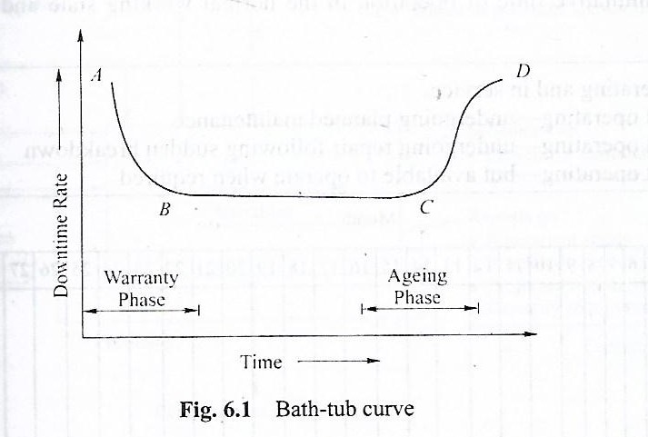
Failure Analysis – Bath Tub Curve

Slide 7
Failure Analysis – Infant Morality
Infant Morality (A-B) – New or recently serviced equipment is initially at a higher risk of failure (less reliable) due to minor breakdowns, vulnerable/damaged components.
- Such behavior can be approximated to a “Hyper Exponential” distribution. This behavior indicates design and installation defects. Warranty Phase is provided to cover this types of failure.

Slide 8
Failure Analysis – Negative Exponential
In this phase (B-C), failure risk is near constant that can be approximated to a “Negative Exponential” distribution.
- Here morality rate is relatively stable
- The equipment become progressively more reliable, i.e., the number od breakdowns in a given period of operation reduces to a minimum average failure rate.
Formula: F = N/T = 1/MTBF;
- where F = Failure rate; N = number of failure encounter in operating time T; T = operating time & MTBF = mean time between failures

Slide 9
Failure Analysis – Abnormal Exponential
In this phase (C-D), components fail due to ageing and wear-out and the failure risk will increase with operating time. This phenomenon can be approximated to a “Abnormal Exponential” distribution.
Weibull Distribution
- Three distributions as discussed above (1) Hyper, (2) Negative, and (3) Abnormal can be combined into one and known as Weibull Distribution as represented by Bath-tub Curve.
- The profitable decision in engineering is the one that costs the least over a defined period which may be called the “Life Cycle of the Equipment”.

Slide 10
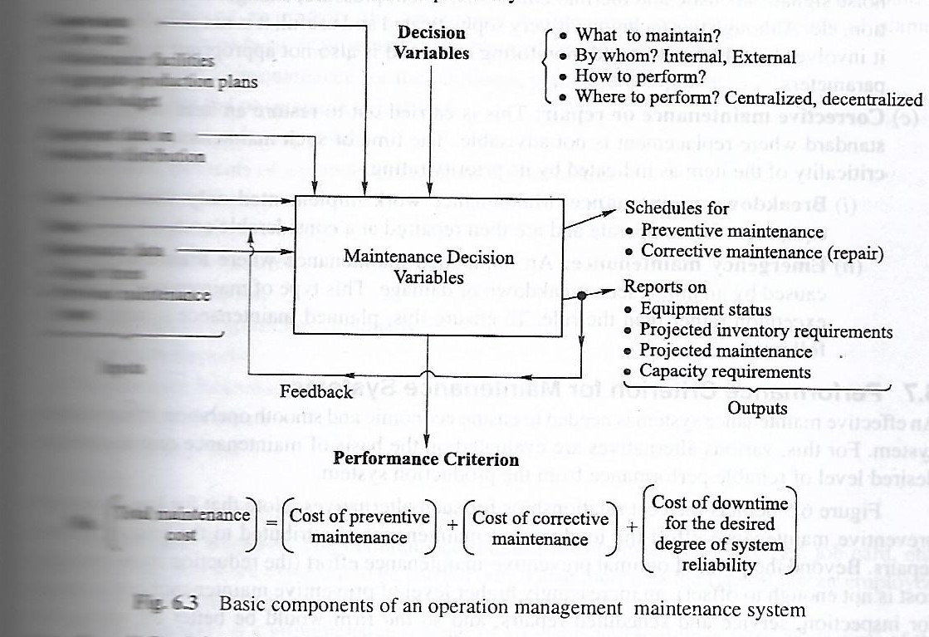
Basic Components of an Operation Management Maintenance System – p/141
Constraints:
Crew size
Maintenance facilities
Aggregate-production plan
Capital budget
Equipment data on breakdown distrib.
Cost
Status
Maintenance Data
Above are Inputs
Total
Maintenance
Cost
Min.

Slide 11
Types of Maintenance – p/140-142
Maintenance
Planned Maintenance
Preventive
Corrective
Unplanned Maintenance
Emergency Maintenance
Running Maintenance
Shutdown Maintenance
Breakdown Maintenance

